Slide 1
Assignment
26-03-2025
Presented by S. Vinish

Slide 2
ITIL
Information technology infrastructure library

Slide 3
What is ITIL?
ITIL – Information Technology Infrastructure Library
ITIL is a set of best practices and guidelines for managing IT services & aligning with business models.
Provides framework of it service management that aligns it services with business requirements.
It provides a systematic approach to IT service management (ITSM).

Slide 4
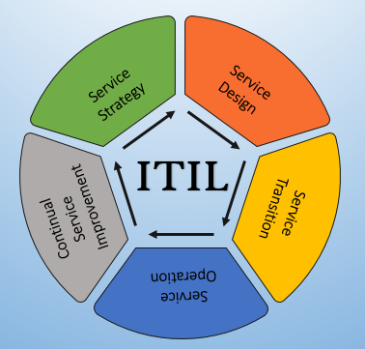
ITIL Service Lifecycle

Slide 5
ITIL Service Management Lifecycle for continuous Improvement

Slide 6
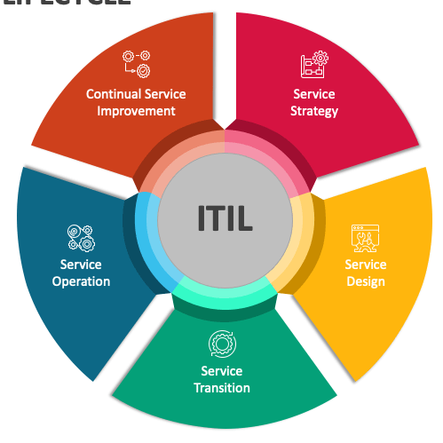
Service Operation
Ensuring services are delivered efficiently and effectively on a day-to-day basis.
Service Strategy
Defining the services and aligning them with business goals.
Service Transition
Managing changes and deploying new services or updates
Service Design
Designing the processes, systems, and infrastructure to deliver IT services.

Slide 7
Why ITIL?
Improves Service Delivery
Reduces Costs
Aligns IT with Business
Enhances Customer Satisfaction
Encourages Continuous Improvement

Slide 8
7 Guiding Principles
ITIL 4 provides 7 flexible principles to guide IT management, including:
Focus on Value
Start Where You Are
Progress Iteratively with Feedback
Collaborate and Promote Visibility
Think and Work Holistically
Keep It Simple and Practical
Optimize and Automate

Slide 9
THANK YOU

